Slide 1
ORIGIN, NATURE & FUNCTIONS OF THE STATE
Module I -Topic I
Tanushree Sanwal
Assistance Professor
KSOM

Slide 2
STATE
Greeks used term
: Polis
Romans
: Civitas & Republica
Medieval period : Christian Common wealth
16th (Century)Machiavelli : Stato

Slide 3
DEFINITION OF ‘STATE’
As a community of
persons,
permanently
occupying a definite territory, legally
independent of external control, and possessing a organized government which create & administrates law over all persons and groups
within its jurisdiction is ‘State”.

Slide 4

State is a historical growth
Product of gradual process of social development
Evolved from simple basic social structures
Not a deliberate creation
Evolved over a long period of time

Slide 5
Aristotle believed that state came into existence for the bare needs of man’s life and continued to exist for his good life
State is result of a slow and steady development of human society
Verges pointed out that to trace origin of State to one factor is wrong, but it is gradual realization of human nature

Slide 6
ELEMENTS OF THE STATE
Population
Territory
Government
Sovereignty

Slide 7
ELEMENTS OF THE STATE
Population : A considerable group of human beings;
Territory : A definite area of earth’s surface upon which the population permanently resides
Government: A political organization through which the
will or law of the state is expressed and administrated.
Sovereignty : the supremacy of the state over all individuals and associations within it and the independence of the state from external control.

Slide 8
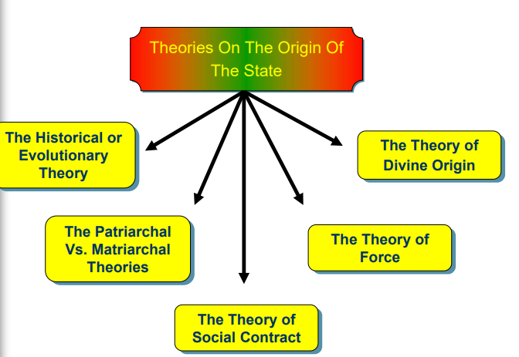

Slide 9
the theory of force
Emphasizes the origin of the State in the subordination of the weak to the strong.
A person physically stronger use to captured and enslaved the weak.
Having increased the number of his
followers, undisputed tribal chief.
over whom authority,
he exercised he became a

Slide 10
The powerful conquered the weak - this process of conquest and domination continued till the victorious tribe secured control over a definite territory
Implications Of The Theory Of Force:
Force is not only a historical factor, but is present essential feature of the State
The States were born of force only

Slide 11
THE FORCE THEORY
In middle ages theologians argued that, the state was based upon force and injustice and decried the origin of earthly sovereignty in order to subordinate temporal to spiritual power.
Individualist & anarchist believe that the State is an evil because of their desire for individual freedom.
Socialist believe that , the state resulted from the aggression and exploitation of laborers by capitalist and attack, not the idea of the state itself.

Slide 12
THE DIVINE THEORY
During the large part of human history the state was viewed as direct divine creation.
Early oriental empires rulers claimed a divine tight to control the affairs of their subjects and this right was seldome questioned.
The Hebrews believed – divine origin

Slide 13
This theory is so enunciated, believed in and accepted, thus, implied:
That God deliberately created the State and this specific act of His grace was to save mankind from destruction.
God sent his Deputy or Vice-regent to rule over mankind.

Slide 14
Theory of Mystical Origin
This was the most popular theory of origin of the state in ancient India.
Kingship was given divine sanction and the king was considered not to be the representative of God but himself a God who contained the powers of important Gods like Indra, Varuna and Agni.
According to A.L. Basham the doctrine of royal divinity was explicitly proclaimed. It appears first in the epics and the law books of Manu.

Slide 15
SOCIAL CONTRACT THEORY
In moral and political philosophy, the social contract is a theory or model, originating during the age of enlightenment, that typically addresses the questions of the origin of society and the legitimacy of the authority of the state over the individual.
Social contract arguments typically hypothesize that, individuals have consented, either openly or tacitly, to surrender some of their freedoms and submit to the authority of the ruler or magistrate, in exchange for protection of their remaining rights.
The question of the relation between natural and legal rights, therefore, is often an aspect of social contract theory.

Slide 16
Thomas Hobbes
He published his book, the Leviathan, in 1651. In this book he gave a striking exposition of the theory of Social Contract.
His object was to defend the absolute power of the monarch and he used the doctrine of the Social Contract to support it.

Slide 17
John Locke
He is an English political philosopher, espoused the cause of limited monarchy in England.
The theory of John Locke is found in his Two Treaties on Civil Government published in 1690 defended the ultimate right of the people to depose the monarch from his authority if he ever deprived them of their “liberties and properties.”

Slide 18
The social contract was no more than a transfer of certain rights and powers so that man’s remaining rights would be protected and preserved.
The contract was for limited and specific purposes and what was given up was transferred to the community as a whole and not to a man or to a assembly of men.
Locke recognized the existence of 3 powers in the civil society or the State: legislative, executive and federative

Slide 19
Jean Jacques Rousseau
He is the great French writer of the 18th century, elaborated his theory in his famous work “The Social Contract” published in 1762.
The State of Nature:
man in this state of nature was a “noble savage” who led a life of primitive simplicity and idyllic happiness.

Slide 20
He was independent, contented, self- sufficient, healthy, and fearless and “without need of his fellows or desire to harm them.”
Emergence of Civil Society:
individuals became a collective unity – a society
“puts his person and all his power in common under the supreme direction of the general will and in our corporate capacity we receive each member as an indivisible part of the whole.”

Slide 21
SOCIAL CONTRACT THEORY
Hobbes ;
It was a state of war, a savage state, men were selfish and aggressive brutes. Every men was the enemy of every other man . To avoid fear and danger of this terrible situation, men agreed to setup an authority.
John Locke;
Life in the state of nature was one of the peace and ease. Freedom and tranquility (harmony) prevailed. Men were bound by the law of nature and possessed certain natural rights, but there was the absence of an agency to interpret and implement the law of nature, so men agreed to create a common authority.

Slide 22
SOCIAL CONTRACT
Rousseau
People led to a ideal life and enjoyed ‘idyllic happiness’ in the state of the nature. But the rise of property produced evils. To escape from them men set up authority by contract.

Slide 23
partriarchal Vs. matriarchal theory
The Patriarchal Theory
State is an enlargement of the family
Originally, the family consisted of a man, his wife and children.
The father was the head of the family and his control and authority was complete in all respects over all its members.

Slide 24
When his children married there was expansion in the original family and it led to the establishment of new families.
But the authority of the father and head of the original family remained unabated as before
all lived and functioned under the recognized authority of the senior living male member of the original family.

Slide 25
The Matriarchal Theory
Mc Lennan, Jenks and Morgan are the notable exponents of the Matriarchal Theory.
They reject outright the proposition that the patriarchal family was the earliest form of society. Kinship could only be traced through mother, matriarch.

Slide 26
The advocates of this theory maintain that patriarchal family is possible where either the monogamous or the polygamous institution of marriage exists.
The earliest form of marriage was polyandry, one wife having several husbands.

Slide 27
the historical or evolutionary theory
It explains that the State is the product of growth, a slow and steady evolution extending over a long period of time and shaping itself into the complex structure of a modern State.

Slide 28
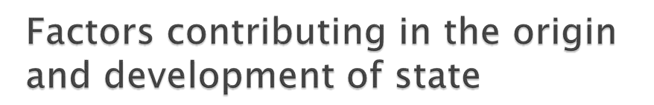
Kinship
Religion
War or Force
Property or Economic Factors
Political consciousness

Slide 29
Kinship- blood relationship played a considerable part in early civic development. It brought members of family together.
Religion- it helped unification of political communities. Religion reinforced sense of unity and respect for authority.
War or Force- military was used for defense and conquest. A sense of loyalty to the ruler was established. It helped in development of political sovereignty.
Property or Economic factors- protection of property from military raids played important role in state building
Political consciousness- the awareness to have a common authority to meet certain common ends helped in state building.

Slide 30
NATURE & ROLE OF THE STATE
State has always been central to the political analysis, to such an extent that politics is often understood as the study of the state.
Two key debates on State
The first : focus the need for the state and the
basis of political obligations
Second : concerns the nature of the state power

Slide 31
NATURE & ROLE OF THE STATE
Idealist theory of state
Marxist theory of state
Liberal theory of state

Slide 32
IDEALIST THEORY OF POLITICS
Plato & Aristotle are considered to be founders of the idealist theory.
They started the premise that man is by nature a social and political animal.
It is only by living in society that man can develop his personality and realize all that is best in him. They never differentiated society with the state.
They regarded the state as a self-sufficing entity identical with the whole of society, existing for itself and by itself.

Slide 33
MAJOR EXPONENTS
Immanuel Kant (1724-1804) is regarded as father of idealistic theory. He gives expression to this doctrine in his famous book "metaphysical first principles of theory and law" in 1796. Kant major focus of analyzing is put of different aspect of state and its relation with other element existing within state.
Hegel, His philosophy had made state to rise to mystical heights and held that German people have divine mission to fulfill in their relation to rest of the world. .

Slide 34
FEATURES OF IDEALISM
State is an ethical institution-state is an ethical institution. Though there are many ethical institutions in a society like Church, family etc but State is most important among them
State is man's best friend-State is man's best friend. All the welfare of an individual is done by the activities of state, it provides all basic necessity to an individual growth and development within the state. State activities is always focused towards individuals welfare.
State has got its independent will and personality-The state is not the sum-total of the individuals. But it has its own independent personality and will. The basis of the state is will and not the force

Slide 35
FEATURES
state is creator and protector of the rights of the individuals- State is considered as guardian and protector of the rights of an individual. State is considered as source of all freedom and rights provided to any individual.
Man is a social animal- Idealism begins with Aristotle's view that man is a social animal. This social animal development is enriched under the proper guidance of state. State is indispensable to effective organization and realization of moral ends.

Slide 36
MARXIST THEORY OF THE STATE
The early Marxist thinkers considered , the state as an instrument of exploitation in the hands of the dominant class.
The state does not stand for the good of all, rather it protects and promotes the interest of the few at the cost of many.
The state is an agency of class coercion in the hands of the dominant economic class.
The state maintain its exploitative class character right from its origin through various phases in developments.

Slide 37
MARXIST/ STATE
State is an instrument of class domination
State comes into existence for the protection of private property
State is a symbol of injustice

Slide 38
NEO-MARXIST THEORIES OF STATE
Max Webber rejected Marx’s class theory
And stressed on the autonomy of state power .
According to Webber, the state has its own powerful resources, it enjoys executive control over legitimate use of force in society which is not accessible to private interests.
It maintain a strong organization in the form of bureaucracy which can formulate, implement and monitor the policies of the state. The state power could not be reduced to an instrument of class interests.

Slide 39
NEO-MARXIST/ STATE
Antonio Gramsci (1891-1937)
Neo-marxism seeks to analyze the subtle aspects of the phenomena of dominance, and dependence, distortion in contemporary civilization and the possible ways to human emancipation.

Slide 40
NEO-MARXIST/ STATE
According to Gamsci, a web of beliefs and
institutional as well as social relations in the society such as family, school, church, and other primary groups play a leading role in the creating consent which he describes as hegemony that keeps the capital system going on. Use of force is restored to only when the instruments of consents fail to work.

Slide 41
LIBERAL THEORY OF STATE
A liberal state adopt a liberal attitude towards the rights & privileges of the citizens.
The restrictions of any type adopted by the government will curb the liberty and spontaneity of the individuals. It will slow down the growth of mans personality and inherent qualities.
So liberal state donates a limited government or limited state.
A state is liberal when it acknowledges the opinions, attitudes and behaviors of individual and does not think these as a threat to existence and administration of state.

Slide 42
FEATURES OF THE LIBERAL STATE
The liberal state embraces multiplicity if ideas, views and existence of numerous groups and parties.
The liberal state maintains absolute neutrality towards all groups. Since multiplicity of groups and organizations and coexistence among them are the characteristic features of a liberal state, clash of interest can be seen as an inevitable consequence.
It is accountable to the citizenry for all its activities, decisions, and policies. The consent and account ability are the twin ideas associated with the liberal state.

Slide 43
QUESTIONS
What are the elements of the state?.
Population
territory
government
sovereignty
What are the major theories of the origin of the state
The force theory
o the divine theory
o the social contract theory
Hobbes views on social contract ?
John Locke Views on social contract ?
Rousseau views on social contract.?

Slide 44
QUESTIONS
What are the evolutionary theory of the state?.
Kinship
Religion
industry
war
What are the nature and role of the state (major theories )
Idealist theory of state
Marxist theory of state
liberal theory of state

Slide 45
SOVEREIGNTY
The state come into being when an independent group of people are organized by means of a government which creates and enforces laws.
Within this group there must be supremacy and will and power.
It must contain some person or body of persons whose commands receive obedience who can, if necessary, execute those commands by means of force.
Such person or body of person exercise sovereignty and such commands are called laws.
Evidently there can no limit to sovereignty.
The state is legal sovereign, there can be no legal limit to lawmaking power of the supreme law making associations.

Slide 46
CHARACTERISTICS OF SOVEREIGNTY
Absoluteness: there can be no legal power within the state superior to it, and there can be no legal limit to the supreme law-making power of state.
Universality: the sovereignty of the state extends over every person and every association of persons in the state.
Permanence: the sovereignty of the state continues as long as the state itself exists. Only by the destruction of the state sovereignty be destroyed.
Indivisibility: there can be one sovereignty in the state. To divide sovereignty is to destroy it. The exercise of its power may be distributed among various governmental organs but the sovereignty is a unit, just as the state is a unit.

